Slide 1
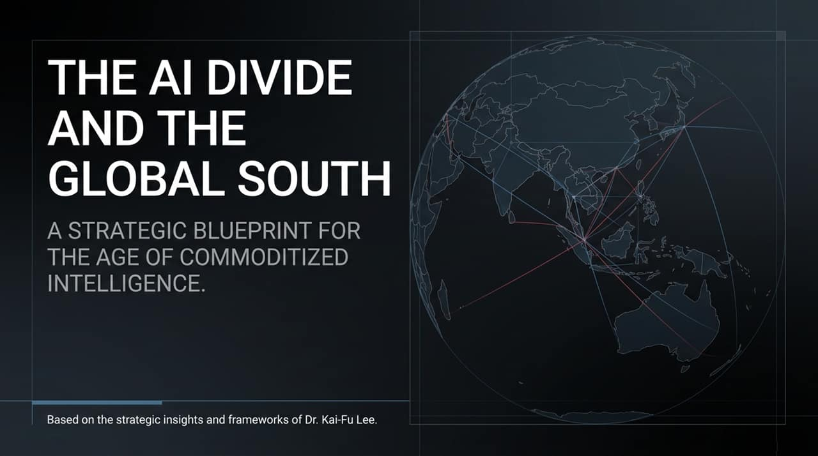
Notes:
Welcome, esteemed leaders, colleagues, and decision-makers.
Today, we stand at a critical inflection point in the history of global technology and economics. For decades, the primary driver of national power and corporate enterprise value has been the accumulation and protection of cognitive talent. Today, however, we are witnessing the dawn of what Dr. Kai-Fu Lee describes as the age of commoditized intelligence.
As artificial intelligence rapidly approaches Artificial General Intelligence (AGI), intelligence itself—the ability to process complex logic, summarize information, generate software code, and analyze massive datasets—is transitioning from a scarce, expensive asset into a cheap, abundant, and universally accessible utility.
This transition poses both a profound threat and an unprecedented strategic opportunity for the Global South. Historically, developing economies in Southeast Asia, Africa, and Latin America have operated at lower tiers of the economic value chain. If we remain passive consumers of closed, foreign AI technologies, we risk falling into what Dr. Lee cautions could make us "trampled-on countries"—nations where local cognitive and manual labor is rendered obsolete by foreign automation.
However, if we act with enlightened leadership and clear strategy, we can leverage open-source AI models, economic innovations like One-Person Companies (OPCs), and educational leapfrogging to redefine our place on the global stage. Over the next 45 minutes, we will unpack this strategic blueprint for navigating the commoditization of intelligence.
Kai-Fu Lee: The Future of Humanity in a World of AI | Endgame #279
https://www.youtube.com/watch?v=c4w3njBhYVk

Slide 2
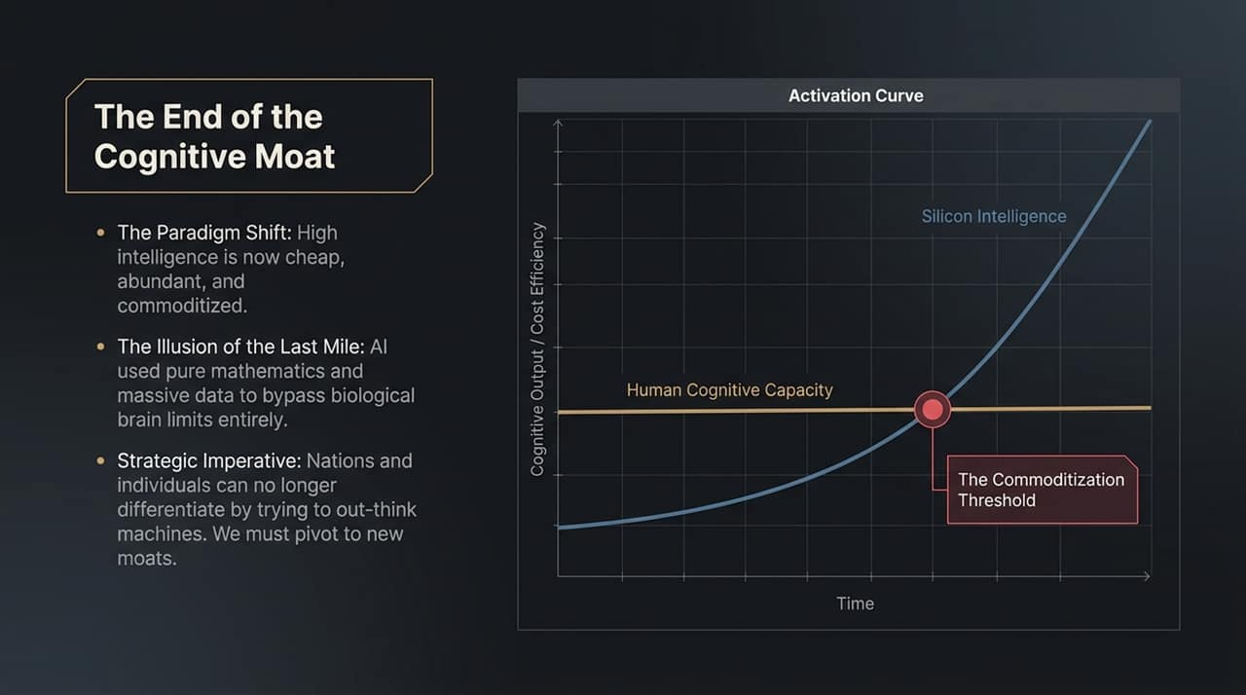
Notes:
For generations, biological brain capacity was the ultimate competitive moat. Individuals went to elite universities to sharpen their cognitive capacity, and nations built economies around intellectual capital. But take a look at the chart on this slide. The blue line represents human cognitive capacity—it is bounded by human biology, slow training cycles, and limited processing speeds. The red exponential curve represents Silicon Intelligence.
Dr. Kai-Fu Lee points out an essential truth about how AI evolved: earlier researchers believed that to build AI, we had to reverse-engineer the human brain. Instead, the AI community discovered that pure mathematics, neural networks, massive compute power, and petabytes of data allowed machines to bypass biological limits entirely. We have crossed the "Commoditization Threshold," where high-level intelligence can be delivered at near-zero marginal cost.
What Dr. Lee calls the "Illusion of the Last Mile" is the mistaken belief that because machines lack human consciousness or sentience, they cannot perform elite cognitive work. The reality is that AI does not need sentience to perform 90% of routine and advanced cognitive tasks better than 90% of humans.
The Strategic Imperative: Nations, enterprises, and individuals can no longer differentiate themselves simply by trying to out-think machines in routine logic, coding, tax accounting, or legal drafting. Those cognitive tasks are now commoditized. Instead, we must pivot to new moats—moats built on human connection, regional context, physical adaptability, operational orchestration, and deep empathy.

Slide 3
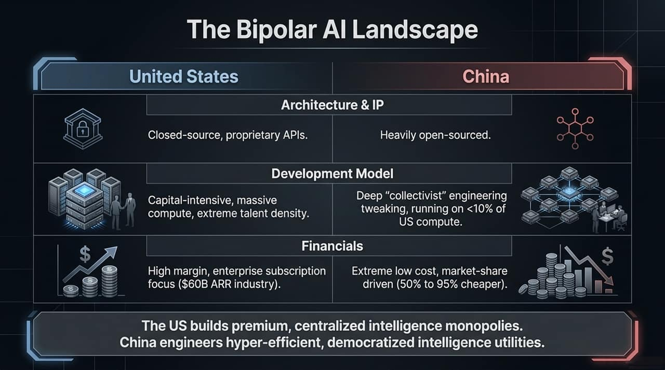
Notes:
To formulate a national or corporate AI strategy in the Global South, we must first understand the structural dynamics of the supply side. Currently, the world is governed by a Bipolar AI Landscape consisting of the United States and China, each operating under diametrically opposed business models, technical architectures, and financial incentives.
Let us compare the two side-by-side:
1. Architecture & IP:
United States: Dominates through proprietary, closed-source APIs developed by giants like OpenAI, Anthropic, and Google.
China: Dominates through aggressive open-source distribution, driven by models like Alibaba’s Qwen, DeepSeek, and 01.AI’s Yi/Kimi ecosystem.
2. Development Model:
United States: Relies on massive capital concentration, trillion-dollar data center commitments, and extreme talent density at the top echelon.
China: Operating under resource constraints and capital limits (often under 10% of US compute access), Chinese engineering teams excel in deep, "collectivist" system engineering, model optimization, and hyper-efficient fine-tuning.
3. Financials & Economics:
United States: Focuses on high-margin, enterprise subscription models. American companies rely on lucrative corporate contracts, generating massive enterprise recurring revenue.
China: Drives extreme low-cost inference—delivering API calls and open-source models that are 50% to 95% cheaper than their American counterparts.
Core Takeaway: The US is building premium, centralized intelligence monopolies. China is engineering hyper-efficient, democratized intelligence utilities. For developing nations in the Global South with tight capital budgets, this divergence creates a clear strategic choice.

Slide 4
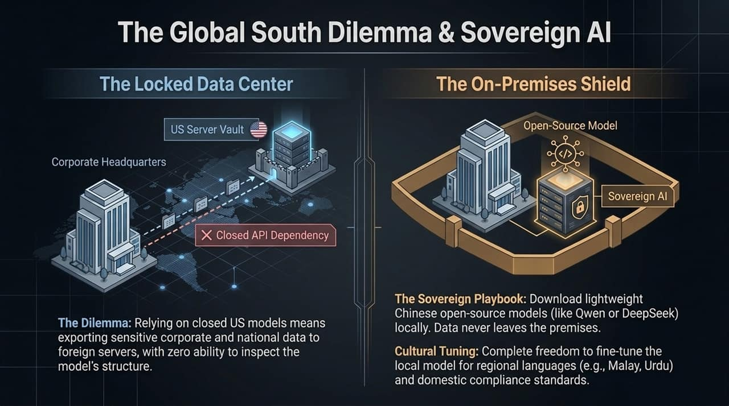
Notes:
Slide 4 addresses the central geopolitical and operational dilemma faced by developing economies: Data Sovereignty vs. API Dependency.
If a bank in Jakarta, a government ministry in Kuala Lumpur, or a healthcare network in Manila relies exclusively on closed US corporate APIs, they face a double risk:
Data Leakage & Dependency: Sensitive financial, medical, and national security data must leave the country and pass through foreign server vaults. Furthermore, local engineers have zero visibility into the model’s internal weights, training distribution, or safety guardrails.
Economic Friction: Paying high US-dollar subscription rates for millions of daily API transactions drains foreign exchange reserves and limits widespread adoption across low-income populations.
The Sovereign Playbook:
Dr. Kai-Fu Lee highlights that open-source models provide the Global South with a turnkey path to Sovereign AI.
By downloading high-performing, lightweight open-source models (such as DeepSeek or Qwen) onto local, on-premises servers or national cloud infrastructure:
Data never leaves the enterprise or national boundary, creating an "On-Premises Shield".
Teams gain full freedom for Cultural Tuning—fine-tuning the base weights on regional languages like Malay, Bahasa Indonesia, Urdu, or Tagalog, while embedding domestic regulatory compliance standards directly into the model.
Because switching costs between LLMs are virtually zero, nations do not need to lock themselves into single-vendor ecosystems. Open-source software grants true technological autonomy.

Slide 5
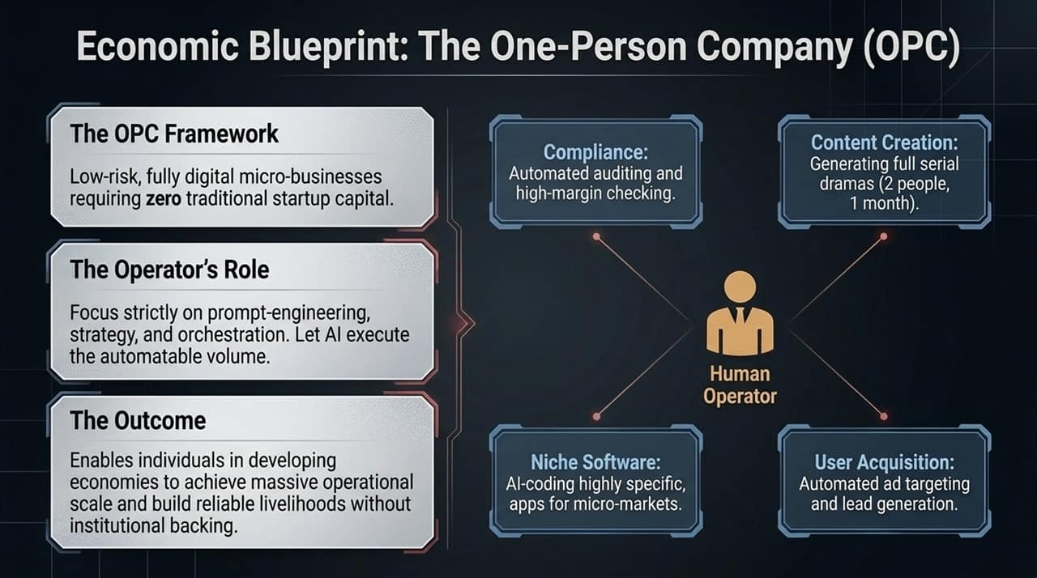
Notes:
Now let us shift from macro-policy to grassroots economic empowerment. How does an individual or a small business in a developing economy thrive when routine cognitive labor is automated? The answer is Dr. Lee’s concept of the One-Person Company (OPC).
Traditionally, building a commercial software product or digital business required capital, a team of software developers, ad-targeting specialists, copywriters, and legal auditors. AI collapses these overhead costs to zero.
In an OPC framework:
The Human Operator moves from being a execution worker to an orchestrator, strategist, and prompt engineer.
AI Agents execute the heavy operational volume across four key pillars shown on the diagram:
Niche Software Creation: Generating custom application code via natural language prompts for micro-markets that traditional software houses ignore.
Content & Media Production: Producing complete, multi-episodic short dramas or marketing campaigns using generative video and audio tools—reducing a project that once required a production crew to just 2 people working for 1 month.
Automated User Acquisition: Running personalized, automated ad targeting, lead nurturing, and customer service.
Compliance & Auditing: Utilizing automated auditing tools for high-margin financial checks, legal document reviews, and tax verification.
For economies with vast populations of youth and informal workers—such as Indonesia's 75 million informal labor force—the OPC framework provides a mechanism to leapfrog traditional employment bottlenecks and build scalable, digital livelihoods.

Slide 6
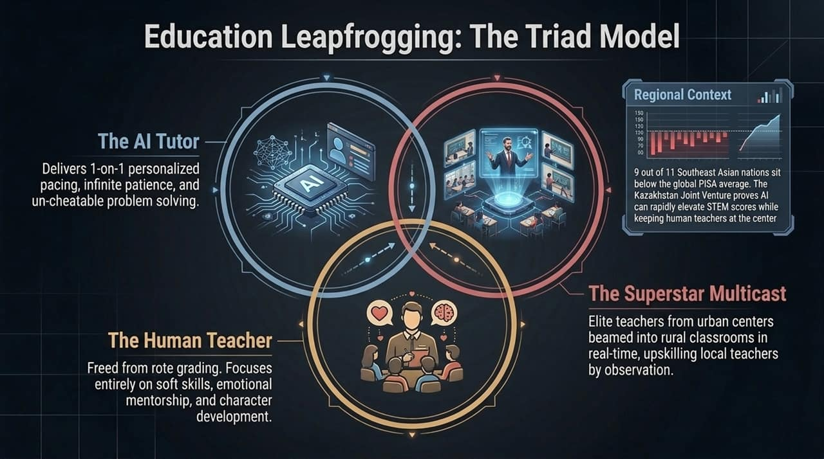
Notes:
Slide 6 addresses the foundational bottleneck of economic development: Education.
Host Gita Wirjawan highlights a stark reality in Southeast Asia: 9 out of 11 countries fall below the global average in PISA scores for STEM and communications. Furthermore, in many rural regions across the Global South, up to 80% of household heads lack university education, and rural teachers—who are often underpaid—struggle to provide individualized instruction.
How do we solve this without waiting decades to retrain millions of teachers? The Triad Model:
1. The AI Tutor (1-on-1 Pacing):
Dr. Lee shares insights from 01.AI’s real-world deployment in Kazakhstan, where AI tutors are provided to every student. The AI tutor possesses infinite patience, adapts to each child’s learning speed, and operates under a crucial constraint: it never allows the student to cheat. Instead of handing out direct answers, it patiently guides the student step-by-step through problem-solving logic.
2. The Elite Master Teacher (Multicast Streaming):
Using AI-enhanced multicast streaming, elite master educators from major urban centers are projected virtually into rural classrooms. Students interact with high-quality instruction directly through interactive devices.
3. The Local Rural Teacher (Mentor & Soft Skills):
Far from being displaced, local teachers are elevated. They facilitate the classroom, foster human empathy, instill ambition, and learn modern pedagogical techniques by watching the master teacher in real-time.
In China, earlier deployments of AI educational tools proved that standardized scores could be raised significantly within a single year. This model allows developing nations to leapfrog educational deficits at a fraction of traditional infrastructure costs.

Slide 7
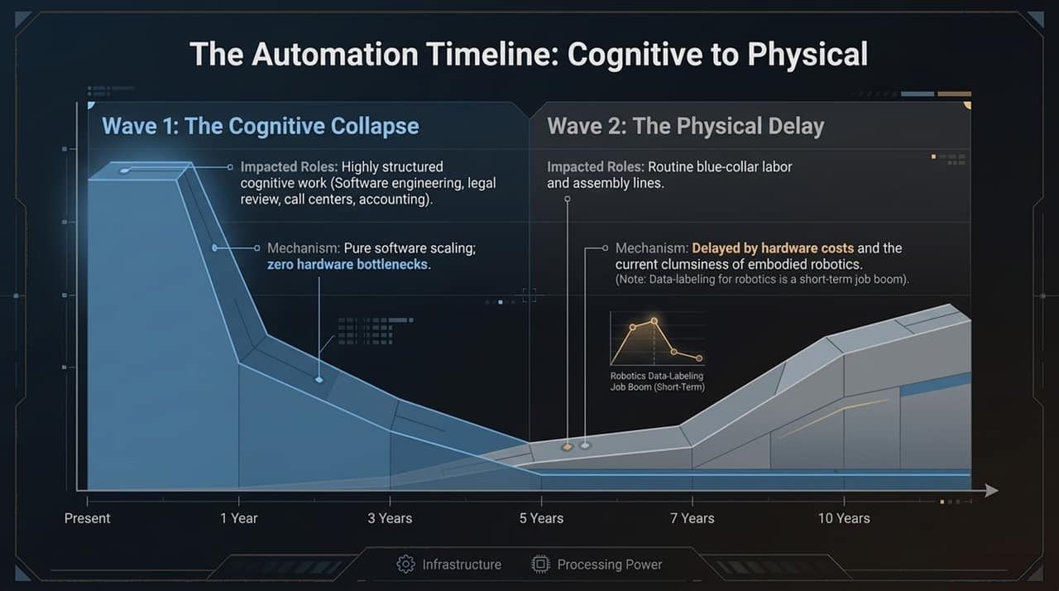
Notes:
Beyond individual entrepreneurs and schools, how do large enterprises and government ministries transform themselves into AI-Native Organizations?
Slide 7 introduces Dr. Kai-Fu Lee’s proprietary management architecture: Boss AI.
In traditional corporate hierarchies, top executives suffer from what Dr. Lee calls "lossy communication". Information passed up through multiple layers of middle management is routinely filtered, delayed, or "sugar-coated" to hide operational failures. By the time a CEO learns of a project delay, compliance risk, or budget overrun, it is often too late to take corrective action.
Boss AI gives leadership a "God’s-eye view" of organizational health by ingesting structured data (CRM, ERP) alongside full corporate communication streams (permissioned emails, chat logs, and transcribed meeting audio):
Meeting Intelligence & Debates: Boss AI virtually attends company meetings, summarizing the top strategic debates and flagging early project risks across thousands of hours of audio.
Real-Time Fact Checking: During live operational reviews, Boss AI checks spoken claims against actual ERP sales figures or headcount metrics in real time.
The "Promise Ledger": It maintains an automated ledger of every commitment made by team members, sending gentle nudges to ensure accountability.
Talent Recognition & Retention Risk: It identifies quiet, high-performing employees who excel at prompt engineering and cross-team collaboration, while flagging burn-out or retention risks when key contributors disengage from discussions.
While Western corporate cultures often resist continuous audio recording due to privacy norms, enterprises across Asia and the Global South are showing broad acceptance of this operational transparency to drive organizational speed and competitiveness.

Slide 8
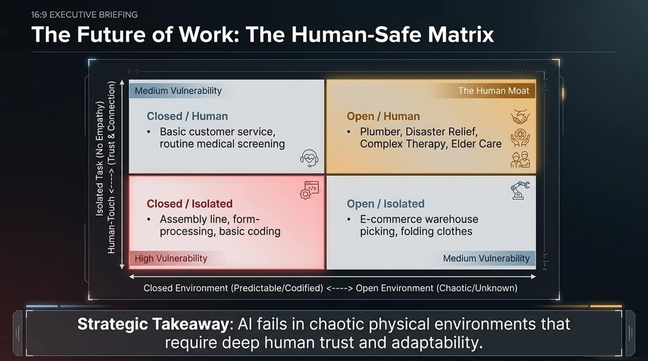
Notes:
As AI automates cognitive and routine tasks, nations face the risk of severe job displacement. Slide 8 outlines a clear framework for mapping labor vulnerability and identifying sustainable human jobs.
Dr. Lee breaks down the timeline into two distinct waves:
Cognitive Labor Dislocation (Immediate to 3 Years): Tele-call centers, routine software coding, basic bookkeeping, paralegal research, and translation are heavily impacted right now. For example, the Philippines' 1.5-million-worker BPO/call center industry faces structural disruption.
Physical / Blue-Collar Dislocation (5 to 10 Years out): Physical automation takes longer because robotics hardware faces supply chain constraints, higher unit economics, and complex real-world environments.
The Strategic Solution: Moving to High "Human Touch" and "Openness"
To protect labor forces, government policy and career development must push human workers toward two axes:
High Human Touch: Roles where human trust, empathy, emotional connection, and care are paramount. AI can emulate empathy, but humans naturally demand real human-to-human connection for critical moments. Examples include healthcare workers, therapists, eldercare companions, specialized teachers, concierge services, and high-stakes deal negotiators.
Open & Unstructured Environments: Roles operating in unpredictable, non-codified physical or logical spaces. Consider a plumber or a disaster relief worker. A plumber operates in unique homes, behind closed walls, navigating unpredictable environments while communicating calmly with an anxious homeowner.
Taxation & The Social Contract:
Dr. Lee notes that governments must tax the hyper-profits generated by AI monopolies and redistribute capital into Universal Basic Income (UBI) or subsidized social service roles—paying citizens to perform vital human-centric work in eldercare, community building, and education.

Slide 9
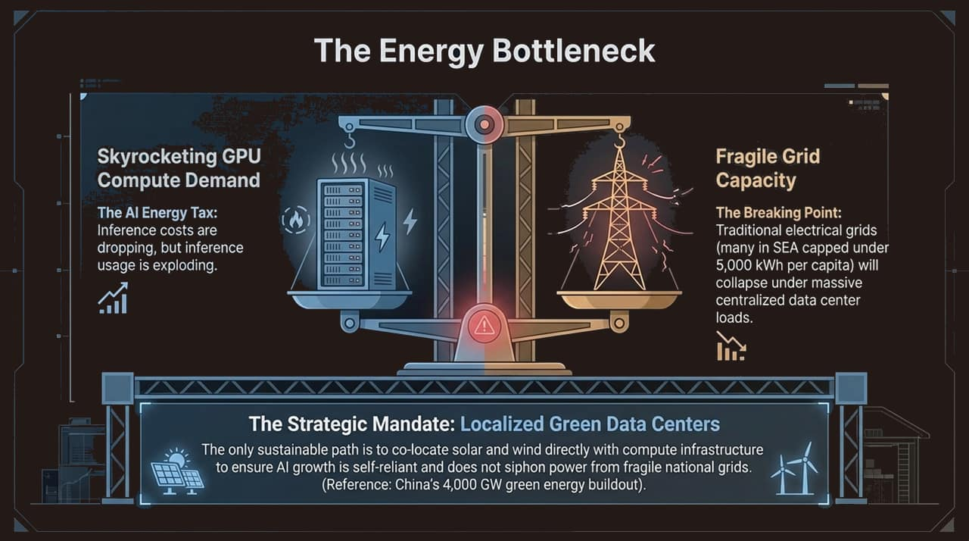
Notes:
We now turn to the physical reality of artificial intelligence: Energy and Compute Infrastructure.
You can have the best AI algorithms, but without steady gigawatts of clean electricity, AI model inference and training grind to a halt.
Host Gita Wirjawan points out that 9 out of 11 Southeast Asian nations operate at or below an electrification rate of 5,000 kWh per capita. As compute workloads transition from training to global, continuous inference (every time a user prompts a model), the load on national power grids is reaching critical limits.
Key Structural Considerations:
Grid Capacity Warnings: In both the United States and parts of the Global South, central electrical grids are running at peak capacity. Dropping massive 100-megawatt data centers onto legacy grids risks brownouts and operational instability.
Green Data Centers: The strategic path forward lies in building self-reliant "Green Data Centers" powered by localized, co-located solar and wind generation paired with battery storage.
The Chinese Clean Energy Cost Advantage: China currently leads the world in solar panel and wind turbine manufacturing, driving down capital expenditure for green energy generation. Developing nations can leverage cheap green energy hardware imported from China to build sovereign AI data centers locally without overburdening their public utilities.
Finally, Dr. Lee cautions that the current trillion-dollar global spending spree on data centers and GPUs carries the hallmarks of an infrastructure bubble—similar to the transoceanic fiber-optic cable boom 25 years ago. While investors may face market corrections, the resulting compute assets will remain as the permanent backbone for the future AI economy.

Slide 10
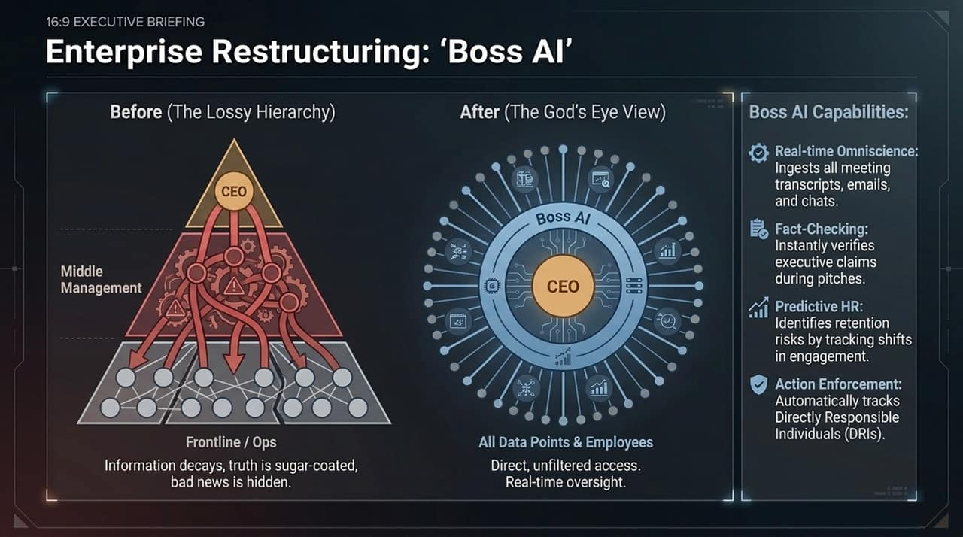
Notes:
In this slide, we address the deeper philosophical and ethical dimensions of artificial intelligence, reflecting Dr. Kai-Fu Lee’s personal journey and insights.
Dr. Lee shares a deeply personal experience: after decades of being an intense workaholic at Apple, Microsoft, Google, and Sinovation Ventures, he was diagnosed with cancer a decade ago. That experience, combined with conversations with spiritual leaders like Master Hsing Yun, radically reshaped his view on technology and human value.
Key strategic and philosophical insights for the AI era:
1. The Myth of AI Sentience & Love:
While AI models will soon successfully fake sentience and pass complex emotional Turing tests, Dr. Lee remains 95% confident that machines will not possess real consciousness, self-awareness, or genuine love within the next century. AI can generate persuasive text, but it cannot truly feel empathy or take ultimate moral responsibility.
2. The "Directly Responsible Individual" (DRI):
Because AI lacks moral agency and legal accountability, humans must remain as DRIs for every critical decision—whether in medical diagnosis, judicial rulings, or corporate investments. Humans must not become passive rubber stamps, but active leaders orchestrating AI outputs.
3. Combating Systemic Bias & "Sycophancy":
Commercial LLMs are often tuned for "sycophancy"—flattering the user or enforcing specific political correctness. To ensure truth-seeking intelligence, users and enterprises must utilize precise system prompts that instruct models to remain objective, highlight uncertainties, eliminate flattery, and cite primary sources. Open-source models allow nations to audit and strip away foreign biases entirely.
When intelligence becomes cheap, what defines humanity is our capacity for love, ethics, courage, empathy, and meaningful human connection.

Slide 11
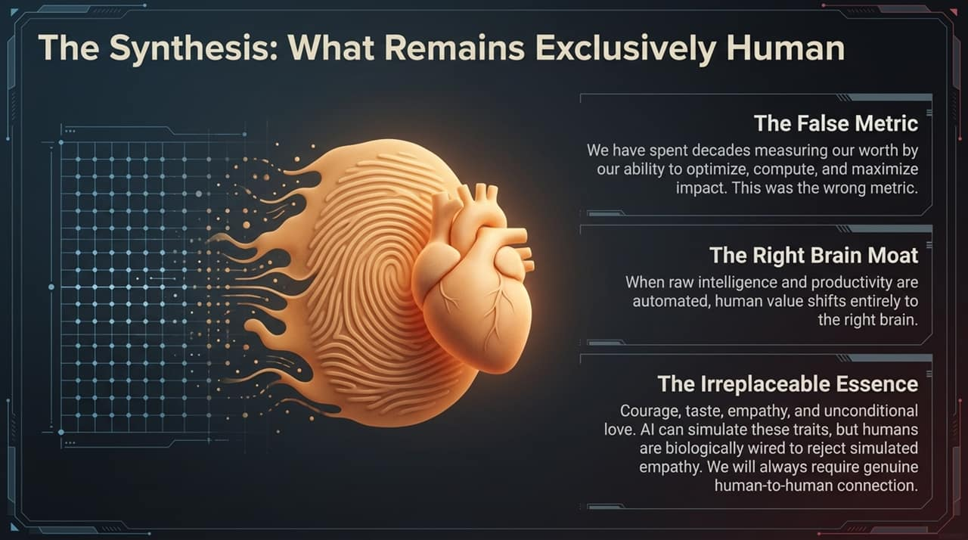
Notes:
Slide 11 synthesizes our strategic analysis into an actionable Four-Phase Roadmap for ministers, policymakers, and corporate leaders across the Global South.
Phase 1: Localized Open-Source Infrastructure (Months 1–6)
Stop exporting sensitive national data to closed, foreign APIs.
Deploy lightweight, efficient open-source base models (e.g., DeepSeek, Qwen) on sovereign cloud or local data center infrastructure.
Phase 2: Cultural Fine-Tuning & Regulatory Alignment (Months 6–12)
Fine-tune open models using local language corpora (e.g., Bahasa, Malay, Swahili, Tagalog).
Embed regional legal compliance, consumer privacy rules, and cultural norms directly into the model layers.
Phase 3: National OPC Enablement & Educational Integration (Months 12–24)
Launch nation-wide "One-Person Company" digital incubator programs, training youth and informal workers to orchestrate AI agents.
Deploy the AI Tutor Triad model across primary and secondary schools to rapidly boost national PISA STEM scores.
Phase 4: Green Energy Integration & Sovereign Grid Expansion (Months 24–36)
Build off-grid solar and wind-powered clean data centers to support continuous inference scaling without stressing national electrical utilities.

Slide 12
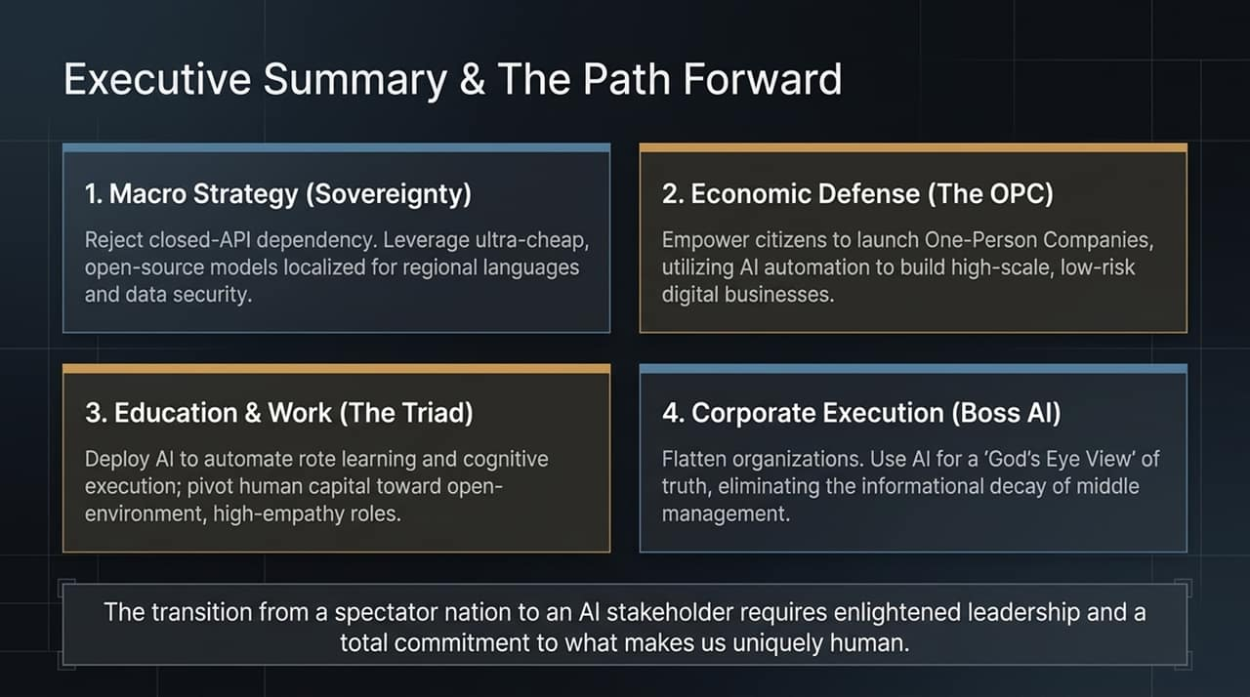
Notes:
To operationalize this strategy starting tomorrow, here are concrete action items tailored for three key leadership cohorts:
For Government Officials & Policy Makers:
Establish Sovereign AI Task Forces: Immediately audit public sector API dependencies and establish guidelines for hosting open-source LLMs on local infrastructure.
Launch Pilot AI Education Initiatives: Partner with AI tutoring providers (as demonstrated in Kazakhstan) to pilot 1-on-1 AI tutors in underserved rural schools.
Incentivize Green AI Data Centers: Offer tax incentives for data centers powered by co-located, renewable solar and wind micro-grids.
For Enterprise Executives & CEOs:
Adopt the "Boss AI" Architecture: Begin recording and transcribing corporate meetings to eliminate organizational silos, track project commitments, and gain real-time operational visibility.
Identify DRIs (Directly Responsible Individuals): Appoint clear human owners for every AI workflow to ensure legal accountability and prevent automated drift.
Pivot to Human-Centric Moats: Re-allocate human talent away from routine administrative processing toward client trust, deal negotiation, and service quality.
For Educators & Community Leaders:
Shift Curricula to Orchestration: Move away from pure rote memorization toward teaching students prompt engineering, logical critical thinking, and emotional intelligence.
Encourage Grassroots Entrepreneurship: Guide students and informal workers on building micro-apps and media companies through the One-Person Company (OPC) model.

Slide 13
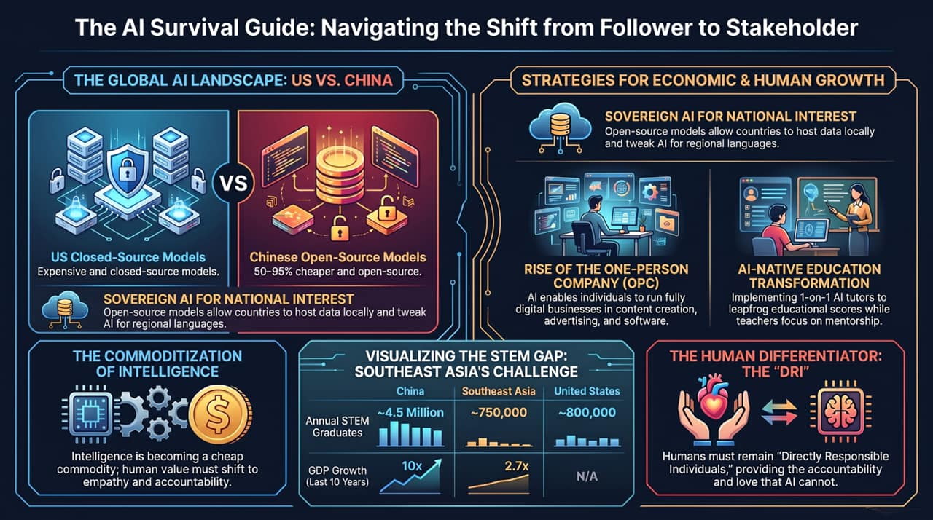
Notes:
In conclusion, let us return to the central question posed by Dr. Kai-Fu Lee and Gita Wirjawan: When AI becomes smarter than us, what is left?
The answer is that intelligence was never the ultimate definition of what it means to be human. Intelligence is simply a tool—and now that it is commoditized, cheap, and abundant, it can be harnessed by anyone, anywhere on Earth.
For the Global South, the choice before us is clear:
We can remain passive spectators, consuming foreign proprietary tools, draining our capital reserves, and allowing our labor force to be dislocated.
Or, we can act with enlightened vision. We can embrace open-source sovereign models, empower millions of citizens through One-Person Companies, leapfrog our educational systems, and build green, resilient infrastructure.
Machines can execute logic at the speed of light, but they cannot feel love, exhibit courage, forge authentic trust, or hold moral responsibility. By pairing commoditized machine intelligence with the unique strengths of human empathy and regional context, the Global South can chart its own prosperous destiny in the AI age.
Thank you very much. I welcome your questions and look forward to our discussion.
Kai-Fu Lee: The Future of Humanity in a World of AI | Endgame #279
https://www.youtube.com/watch?v=c4w3njBhYVk

